Slide 1
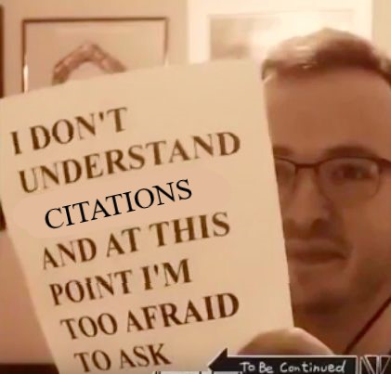
Citing and Writing
Grad Consultant Training 2022

Slide 2
Why we cite:
“Building confidence in the information and ideas we share with one another is perhaps more important today than ever before, and for nearly a century it has been the driving principle behind MLA style, a set of standards for writing and documentation used by writers to find and evaluate information, alert their audience to the trustworthiness of their findings through citation, and shape the expression of their ideas in conversation with others” (“Introduction,” xxi).
“APA Style provides a foundation for effective scholarly communication because it helps authors present their ideas in a clear, concise, and organized manner...When style works best, ideas flow logically, sources are credited appropriately, and papers are organized predictably and consistently.” (American Psychological Association, 2020)
“Find it. Write it. Cite it. The Chicago Manual of Style Online is the venerable, time-tested guide to style, usage, and grammar...It is the indispensable reference for writers, editors, proofreaders, indexers, copywriters, designers, and publishers, informing the editorial canon with sound, definitive advice” (The Chicago Manual of Style 2017).

Slide 3
These styles are crafted by committees and revised every year to fit the discursive needs of their writers

Slide 4
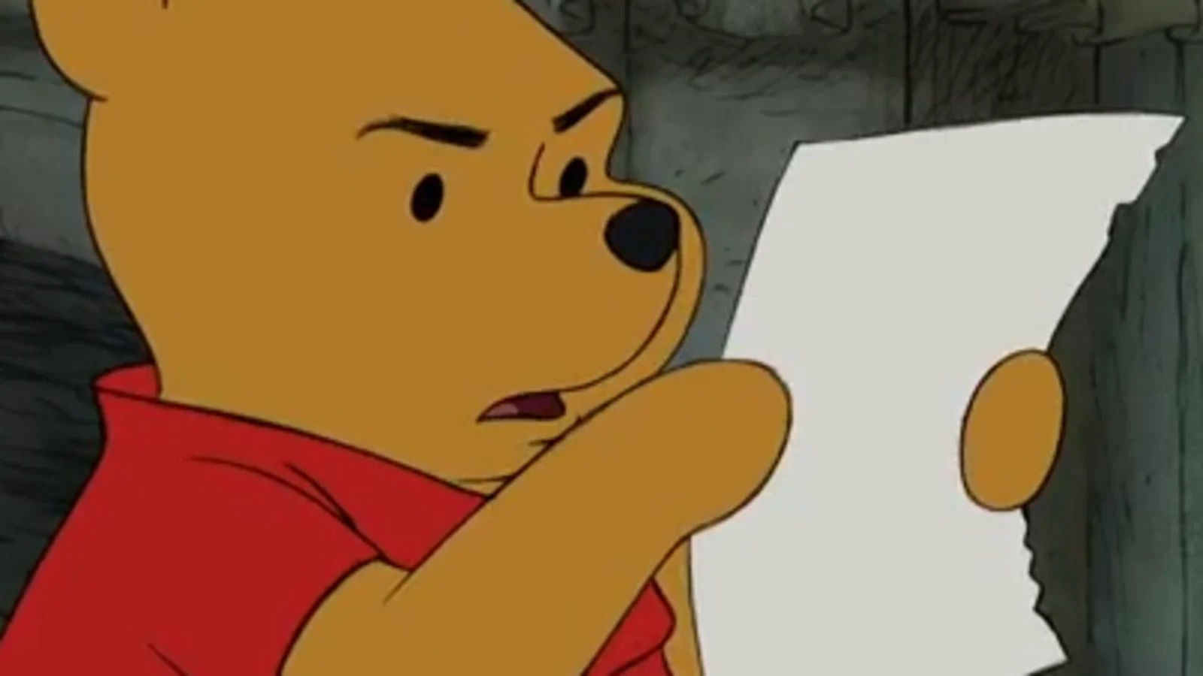
The Struggle
For many graduate students, citation styles are tedious rules that they must follow, instead of general guidelines for communication across their field
Most students struggle with how to cite something, because they don’t know what the source is (journal article, edited book, etc.), or they don’t know how to find the information they need to cite something.
They don’t know that there are plenty of shortcuts and resources for creating and organizing references!

Slide 5
What are some common questions you've heard from grads?

Slide 6
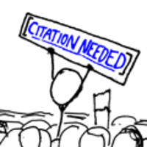
Basics of the Big Three

Slide 7
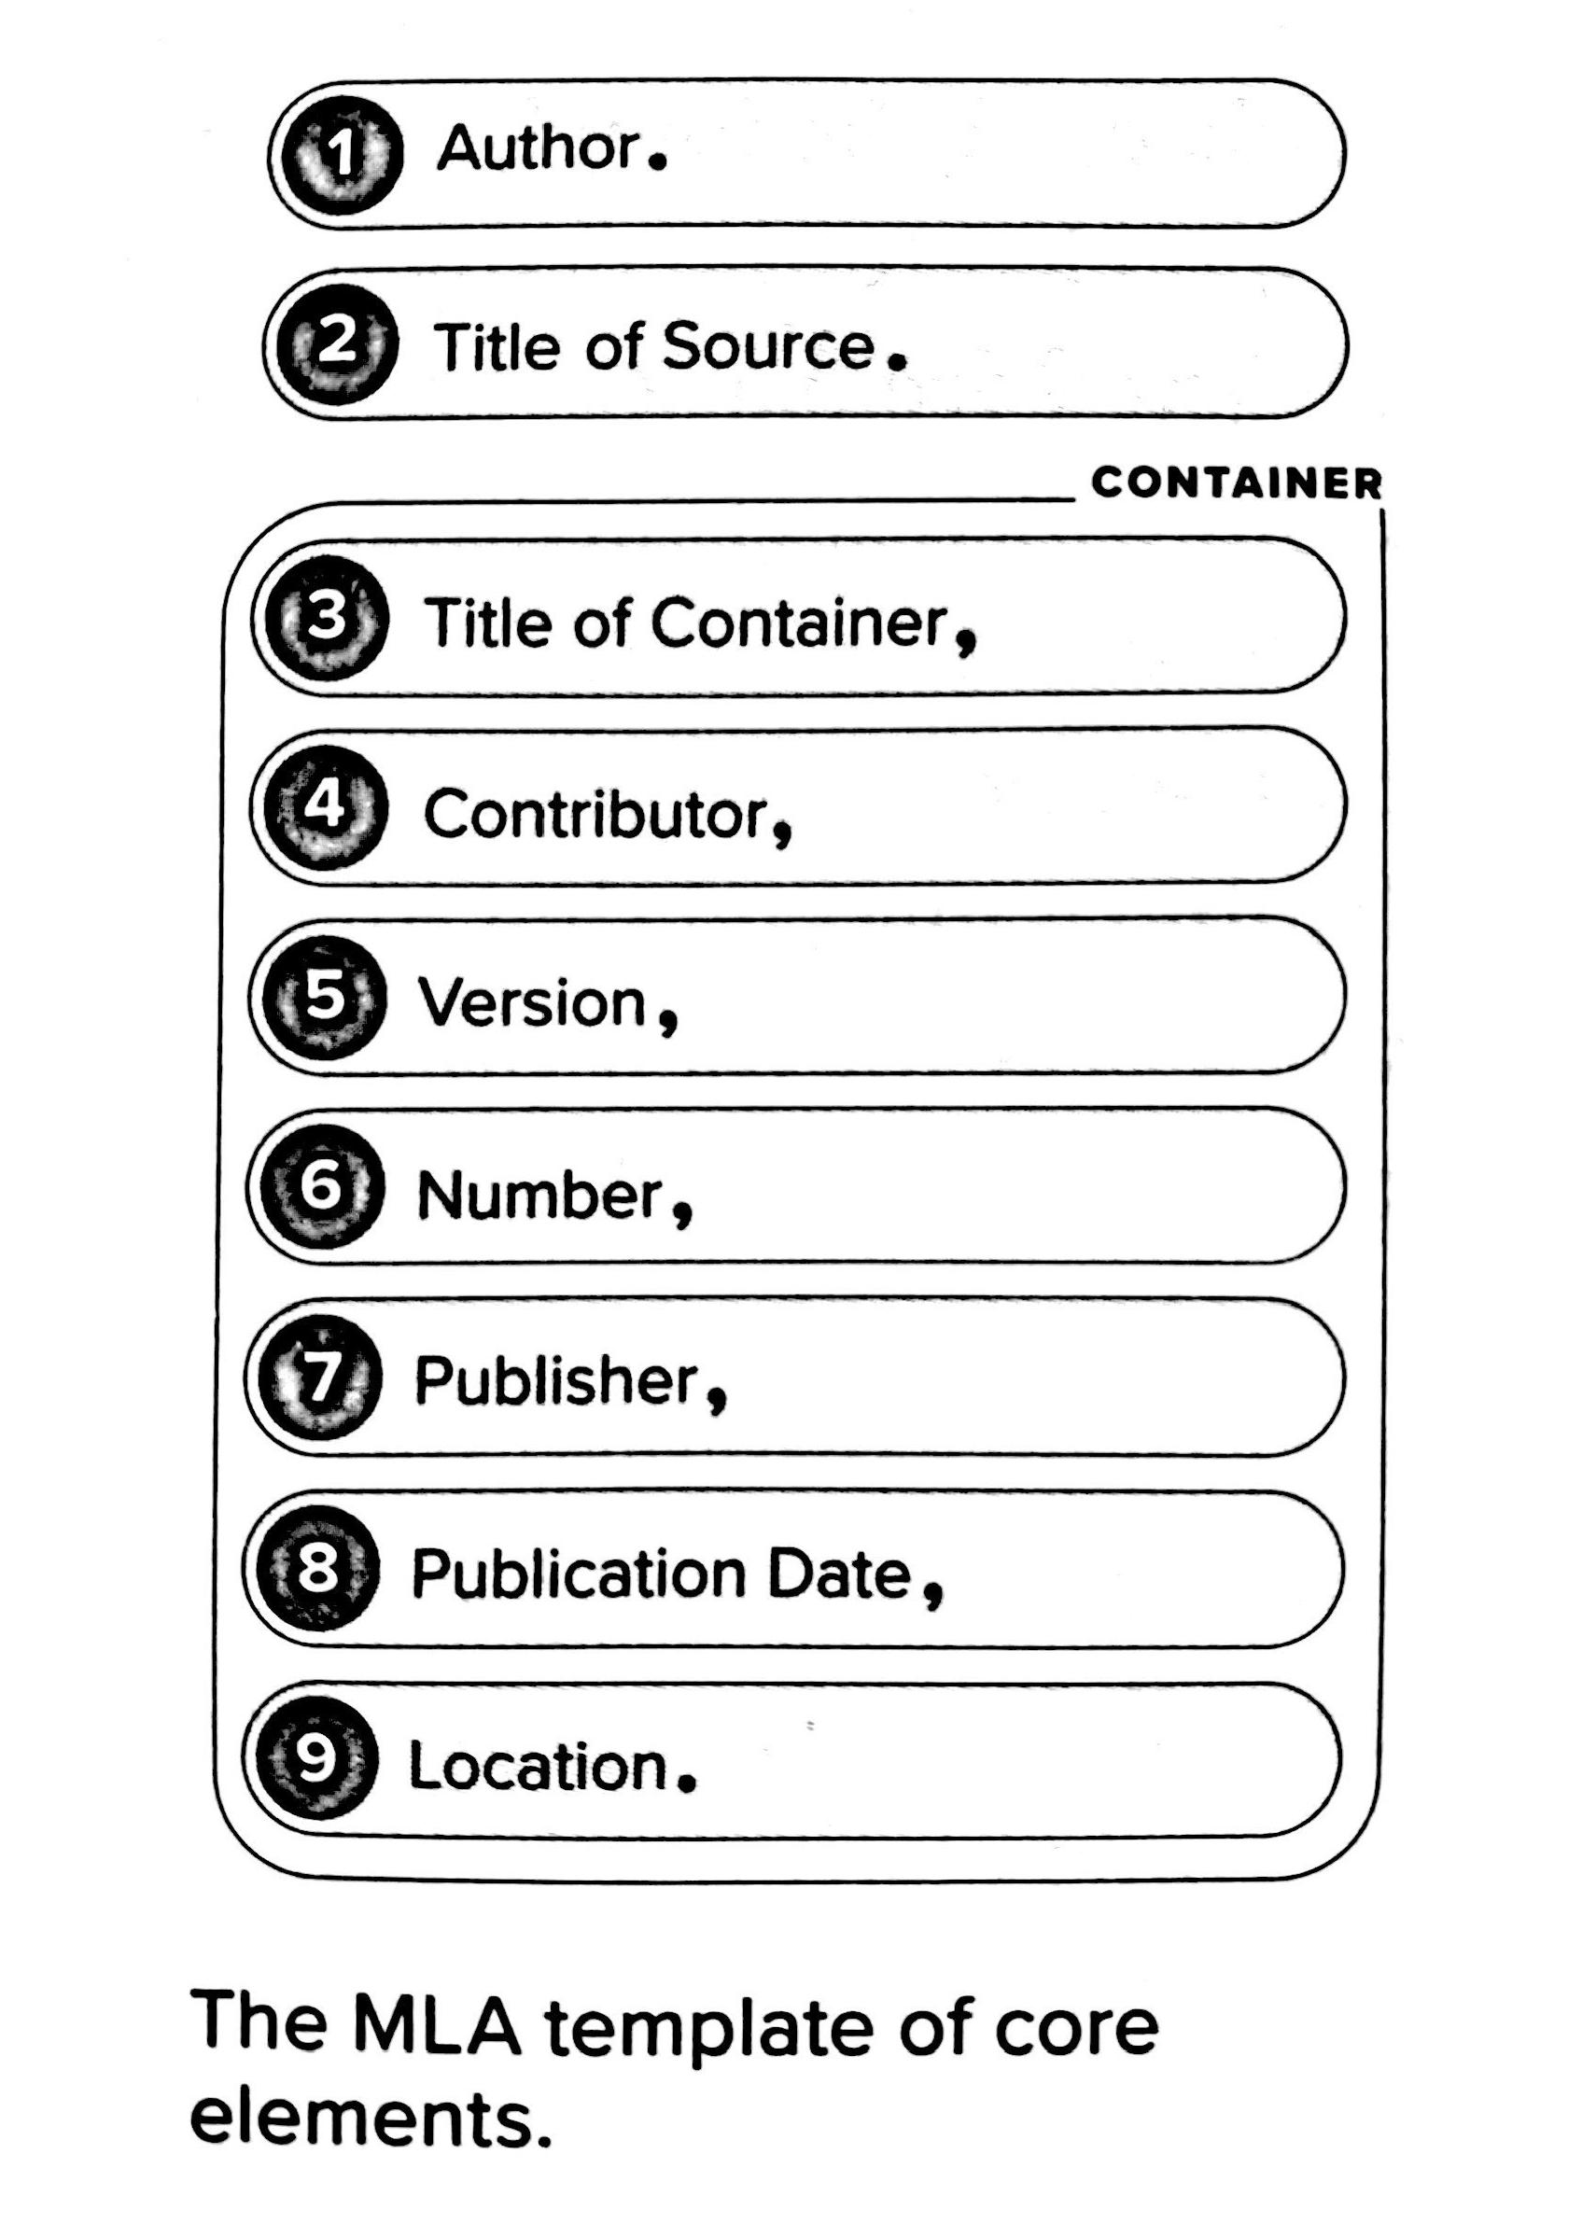
Primarily used in the Humanities and by students
In-text citations are (Name pg#), or whatever information best distinguishes that text from others.
MLA has more comprehensive instructions for various literatures, e.g. Early Modern plays, medieval texts, etc.
Works Cited (instead of References/Bibliography)

Slide 8
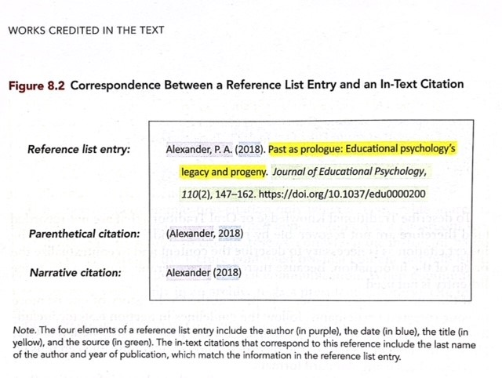
Primarily concerned with the ethics of research and the consistency of reporting findings.
APA Publication Manual has an entire skeleton of Quantitative Design Reporting Standards (Table 3.1) and Qualitative Design Reporting Standards (Table 3.2) can you can use to structure your own paper

Slide 10
Primarily a style for PUBLISHERS.
Has both Note system (footnote or endnote, or both, with bibliography) and Author-Date system.
“Because of this flexibility, the notes and bibliography system is preferred by many writers in literature, history, and the arts...The author-date system is preferred for many publications in the sciences and social sciences but may be adapted for any work, sometimes with the addition of footnotes or endnotes.” (743)

Slide 11
Note System
1. Stuart Shea, Wrigley Field: The Long Life and Contentious Times of the Friendly Confines (Chicago: University of Chicago Press, 2014), 51-52.
1. Shea, Wrigley Field, 138.
Shea, Stuart. Wrigley Field: The Long Life and Contentious Times of the Friendly Confines. Chicago: University of Chicago Press, 2014.
!!!! Warning!!!! Chicago no longer favors the use of Ibid! Just use shortened citations! (759)

Slide 12
Author-Date System
Reference information is basically the same—only publication dates are moved next to the author/item information
Bissell, Tom. 2011. Extra Lives: Why Video Games Matter. New York: Vintage Books.
(Bissell 2011, 87-88)
In the Author-Date system, notes are treated as normal text and require the same kind of parenthetical citations.

Slide 13
Journals
Quotation and citation
After the first quotation from Shakespeare’s works, specify the edition used in an endnote.
After the initial citation for the Shakespeare edition used, cite Shakespeare’s dramatic and poetic works parenthetically in the text. For dramatic works, cite by act, scene, and line; for poetic works, cite by line number. If multiple Shakespeare works are quoted, also include the name of the work in question in the parenthetical citation (e.g., Hamlet, 1.1.1).
Cite works by all other authors (including other dramatists) in endnotes.
Separate run-in lines of poetry with virgules (forward slashes) and include any terminal punctuation at the end of each line.
When quoting more than three lines of verse, or more than 100 words or prose, set off the material as an indented block quotation.
Endnotes
Include complete bibliographic information in endnotes—author, editor, translator and/or compiler, full title, total number of volumes, publisher, year and place of publication, volume, page(s) cited.
To cite an essay in a collection, provide inclusive page numbers for the entire essay, as well as the page quoted: 133–54, esp. 135. (This applies to introductions as well.)
If referencing a specific volume of a multivolume work, as long as all volumes are published in the same year, cite by Arabic volume number, colon, and page number at the end of the reference: 1:192, 4:367. If the volumes of a multivolume work are published in different years, the abbreviation “vol.” with the appropriate Arabic numeral (e.g., vol. 1) should appear before the parenthetical publication information. The date given in the parenthetical publication information should be the date of publication for the specific volume in question.
To cite a note in another work, give the page number on which the note appears, followed by the letter n: 245n.
Omit “p.” and “pp.” when citing page numbers.
Rare materials
Cite all rare books by signature whenever possible; render signatures exactly as printed: ZZZ, not 3Z.
To cite a modern edition or facsimile of a rare book, provide the year of original publication and signature(s), folio(s), or page number(s).
Retain original capitalization, spelling, and punctuation in titles and quotations from early modern sources, except for the long s. Do not modernize.
Each Journal will adhere to one of the Big Three Styles—with a catch. Most Journals have a “House Style” that is specific to them. Shakespeare Quarterly, for example:

Slide 14
Citation Management Tools
Paul Thomas is the Citation Guru: he can help students navigate what citation management software are best for them and help them figure out formatting issues with their thesis/dissertation.
https://guides.lib.ku.edu/etd/ETD_Home
He also offers Zotero/EndNote workshops regularly!
https://guides.lib.ku.edu/c.php?g=95057
ALL grads should be using citation management software. If you meet someone who is not—recommend that they start.

Slide 15
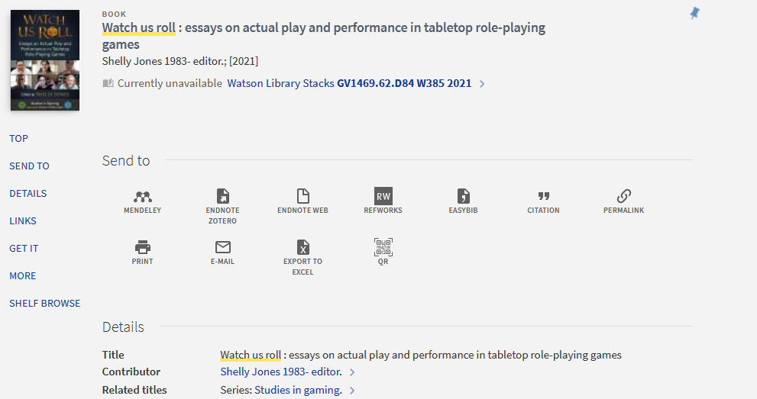
Library Website and Strategies

Slide 16
iThenticate
Notes:
Not a bad person!!! Just need better note-taking strategies—spend some time going logging in

Slide 17
Messy Notetaking Improper Borrowing Plagiarism
“I’m such a sloppy note-taker!”
“In my culture, this is an accepted practice.”
“I have an excellent memory; I had no idea that I was repeating that work verbatim!”
“The pastiche approach is an acceptable postmodern methodology.”
Belcher, Wendy Laura. Writing Your Journal Article in Twelve Weeks. Second Edition, 2009.

Slide 18
Good Citation Habits
Always Revise
Review others’ work briefly rather than at length
Don’t worry about your English
Use a CMS
Develop a clear note-taking system for yourself
Paraphrase without looking at the source
Don’t self-plagiarize
Check that you correctly copied your quotations
Don’t wait to write

Slide 19
Rhetoric of Citations
Signposting
Attributive tags
Your ideas! Your intervention!
Topic sentences and conclusion sentences should be the writer’s own voice.

Slide 20
What would we do?
A Student comes into the Writing Center with a polished draft of a journal article but needs help with the formatting and citations.
A Student is told by their instructor that they're citing incorrectly, but the draft that doesn't seem to be the only feedback from the instructor.
A Student has been out of school for a while and is struggling with the basics of formatting and citation.
A Student brings in a paper with a high similarity score on iThenticate and is panicking.

Slide 21
Final Thoughts
Citation sessions can be “let’s figure this out together” sessions
Citation Styles are puzzles: figure out what identifying pieces you have, how they go together, and how to communicate that to your reader
Walk through resources so they have those strategies for later
Sometimes there are no (immediate) answers to a question!
Citation styles can be an element that is integrated into every stage of the writing process—it does not have to be a “polish” element!

Slide 22
Final Thoughts…?

