Slide 1
Changing the Script on (Dis)Ability:
Universal Design in Learning and Non-Disclosure
Casey Reid, PhD

Slide 2
Prewriting and Thinking
When you think about working with a student with a disability, what feelings, beliefs, and thoughts come to mind?
What do you feel like you need to know to support the student?

Slide 3
Move from Othering and Accommodating to Universal Design in Learning
(Rinnaldi, 2015, citing from Kiedaisch and Dinitz)
“[M]ove away from tutor training that others disabled students by focusing on Universal Design...designing our spaces and practices to meet the needs of a wide range of students”
“[A]ctively try not to think about how you will adjust strategies for a student’s disability (50). Because each student is different, sessions with a tutee with a disability, then, should look no different than any other session (Kiedaisch and Dinitz 50).” Note: We still need to acknowledge disabilities! They do shape identities and perceptions of people.

Slide 4
Objectives
Explain Universal Design in Learning (UDL) and its goals
Use UDL and your experiences to construct a guide for working with students during the beginning, middle, and end of sessions

Slide 5
“The UDL Guidelines”
-Goal: honor learner agency by (re)designing accessible, inclusive learning environments
-Principles: Purposeful, reflective, resourceful, authentic, strategic, action-oriented
-Focus on changing learning environment rather than “fixing” learner and using deficit-oriented view of learner
-Design learning environments that allow for multiple means of engagement, representation, action & expression

Slide 6
The Universal Design for Learning Guidelines

Slide 7
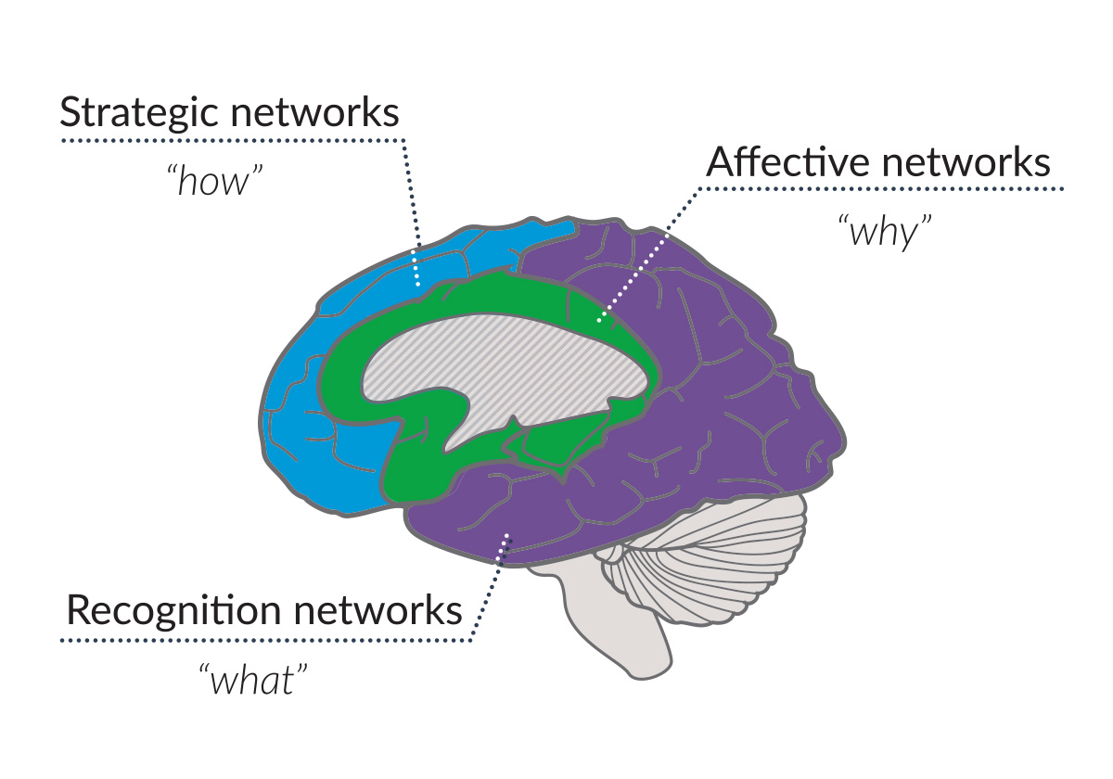
UDL + The Learning Brain
Image courtesy of
CAST (2018). UDL and the learning brain. Wakefield, MA. Retrieved from http://www.cast.org/our-work/publications/2018/udl-learning-brain-neuroscience.html

Slide 8
No Disclosure Needed (Rinaldi, 2015)
What I propose for how we can improve our approach to disability is simply that we apply the same non-hierarchal, collaborative, student-centered approach to students with disabilities as we do with other students. In other words, we stay true to our theoretical ideals, even when—or especially when—a disability is present. One of the most important things to remember when working with a student with a disability, therefore, is that they know themselves best. This means that no matter what we’ve read about that disability, we should defer to the student because that student’s preferences and self-knowledge are far more important than their disability. In fact, I will even go so far as to say that disclosure is not even a necessary part of the conversation when working with a student with a disability. (Rinaldi, 2015)

Slide 9
No Disclosure Needed: Opening Questions
After introductions and goal/purpose setting, ask questions to open up a conversation about the learning process and context:
“How would you like to work together? What works best for you?” (Rinnaldi, 2015)
What has been most difficult about this assignment/question/problem?
Is there anything I should know about how you learn/write that might help us today?
What other questions or strategies do you suggest using to open up discussions about how people learn?
What else can we add to the list above?

Slide 10
While You Work, Use Meta-Discourse
Rinnaldi (2015) defines “meta-discourse” as when a consultant/tutor
talk[s] about what is happening in the session—which can include what a tutor or tutee thinks is currently happening, as well as intentions, goals, and fears. Babcock recommends tutors engage in meta-discourse—by explaining why they are asking or suggesting something—when sessions feel like they are not going the way they are supposed to (“When Something” 10).

Slide 11
Activity: Noticing and Using Meta-Discourse
Sketch out/make notes about a recent session (one you had or overheard) where someone was using meta-discourse.
-What kind of things did you/your colleague say?
-What questions or statements might make up meta-discourse (a.k.a. “what a tutor or tutee thinks is currently happening, as well as intentions, goals, and fears)”? (“When Something” 10)
We’ll take notes on the next slide.

Slide 12
Examples of Meta-Discourse
-Let’s start using … language as we’re talking about [insert topic] so we can…
-Modeling and then explaining
-Silence: “I’m thinking.” Map out what you are seeing/ideas. “Are you drawn to any of these possibilities?” Talk about why. Also, talk about why the changed is needed.
-Read out loud, and explain what you are thinking as you read. Ask, “Would you be okay with/open to reading out loud?” Try to read to put emphasis on different things happening in sentence/idea. Tell students what reading out loud helps us do.
-Read silently. “This sentence doesn’t flow for me. What do you think it means?” Explain what is making it difficult to understand. Talk about how to help us/me understand.
-Self-disclose about our own learning tendencies.

Slide 13
Closing Sessions: Next Steps
Ask: What do you feel like you’ve learned from our time today about both the assignment/problem/homework and your learning process? What is working for you when you’re writing about/learning about… and what isn’t working as well?

Slide 14
Implications and Applications
As part of your reflection for this training, be prepared to write/share:
one or two take aways from the training,
(at least) one thing you will do differently in a session based on our discussions of UDL today, and
(at least) one thing that staff could do to better support your usage of UDL guidelines in our spaces.

Slide 15
Resources
CAST and the National Center on Universal Design in Learning
National Center for College Students with Disabilities (NCCSD)

Slide 16
References
CAST. (2018). UDL and the learning brain. Wakefield, MA.
http://www.cast.org/our-work/publications/2018/
udl-learning-brain-neuroscience.html
CAST. (2024). Universal Design in Learning Guidelines, version 3.0.
http://udlguidelines.cast.org
Rinaldi, K. (2015). Disability in the writing center: A new approach (that’s not so
new). Praxis, 13(1). http://www.praxisuwc.com/rinaldi-131

